Slide 1
The Retina
How it works and how astronomers can take advantage of its structure and function

Slide 2
Brief outline
Discuss the structure and function of the retina, focusing on the answer to three questions:
What is dark adaptation?
Why do we use red flashlights?
How and why does averted vision work?

Slide 3
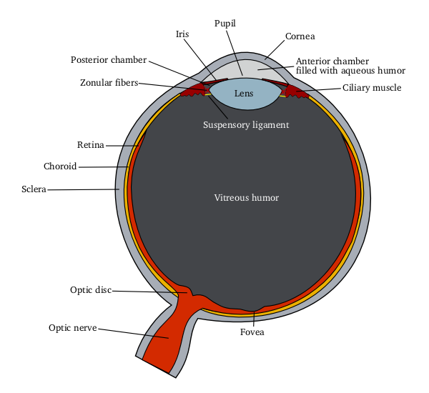
Basic structure of the eye
http://en.wikipedia.org/wiki/Image:Schematic_diagram_of_the_human_eye.png
Notes:
The lens focuses light into a focal plane at the retina. The retina contains photoreceptor cells called rods and cones that transduce the electromagnetic signal into an electrophysiological signal which travels to the brain and is interpreted. Light entering the eye from the center of the visual field strikes at the fovea, a specialized region with densely packed cone photoreceptor cells.

Slide 4
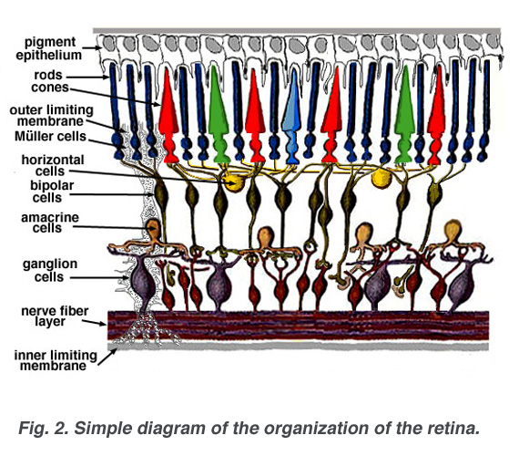
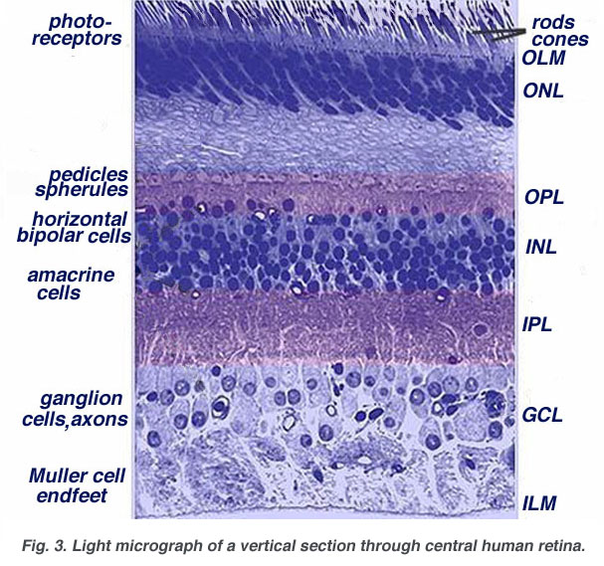
Photoreceptors – Rods and Cones
Diagrams taken from: http://webvision.med.utah.edu/sretina.html
Notes:
Rods and cones are two types of neurons in the photoreceptor layer of the retina. Cones are used for color vision, since there are three types, which are activated by light in the green, red, and blue wavelengths. Rods do not distinguish light based on wavelength; they are just simple light detectors. Rods are used most heavily in night vision.

Slide 5
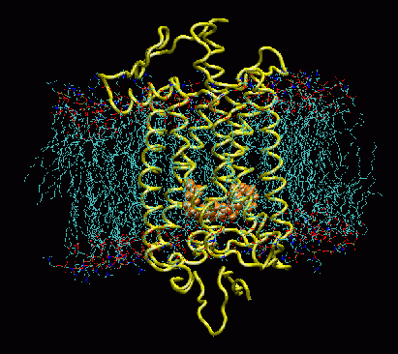
Rhodopsin – the light-detecting molecule in rods
http://www.ks.uiuc.edu/Research/rhodopsin/
Notes:
Rhodopsin is a trans-membrane protein present in photoreceptor cells which contains the chromophore retinal.

Slide 6
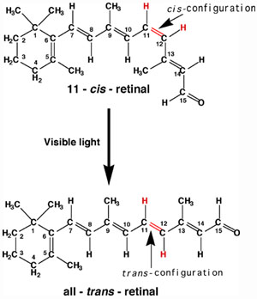
Retinal isomerization – phototransduction in action
Notes:
When in the 11-cis-retinal conformation and struck by a photon, the energy imparted by the photon changes its conformation to all trans-retinal. This induces a change in the conformation of Rhodopsin with two results: 1) activation of the G-protein transducin, which initiates a cascade of reactions that eventually lead to changes in transmembrane voltage and the release of neurotransmitters (a neural signal is sent towards the brain). 2) The all-trans retinal is ejected from the rhodopsin protein, and at some time later, an 11-cis-retinal molecule binds with rhodopsin. Once all-trans retinal is ejected from the rhodopsin protein, it is unavailable for transducing the light signal (it is “bleached). It is transported to the epithelial cells, where it is reduced to all-trans-retinol (Vitamin A), which is the precursor for synthesis of 11-cis retinal.

Slide 7
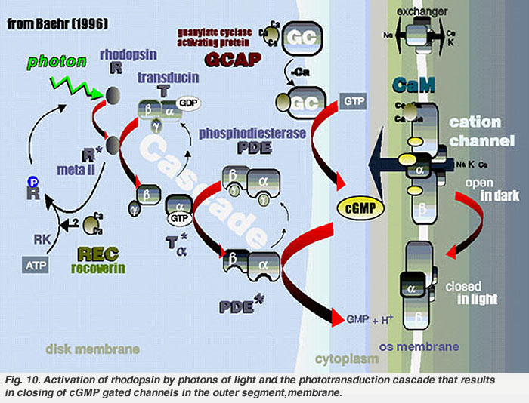
Phototransduction part 2
http://webvision.med.utah.edu/imageswv/cascade.jpeg
Notes:
After being struck by a photon, the conformational change in Rhodopsin kicks off an intracellular cascade that eventually changes the membrane potential of the photoreceptor cell, which alters the neurotransmitter release onto bipolar cells, thus propagating the signal to the next level of processing in the retina.

Slide 8
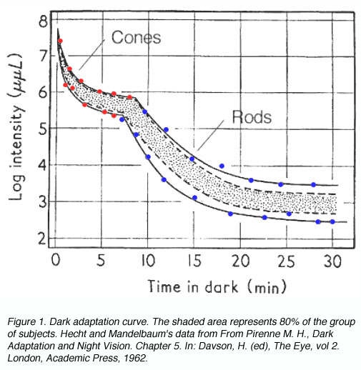
What is dark adaptation?
http://webvision.med.utah.edu/imageswv/KallDark1.jpg
Notes:
Dark adaptation is the process of “bleached” rhodopsin becoming “unbleached”, and thus, increasing the sensitivity of the eye for light detection.
This bleaching occurs on a per-rhodopsin molecule basis; so every photoreceptor cell adapts separately from every other. Which also means that each eye adapts separately. You could use an eye patch over your observing eye and view charts with bright white light and it would not affect your dark adaptation of your observing eye.

Slide 9
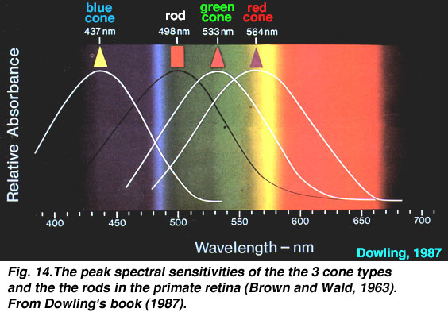
Why do we use red flashlights?
http://webvision.med.utah.edu/imageswv/spectra.jpeg
Notes:
There are four kinds of opsins in humans: rhodopsin, used in rods, and three kinds of “cone opsins”, or photopsins.
Rods use the dye rhodopsin, and have peak light sensitivity at a wavelength of about 498 nm, in the blue-green part of the spectrum.
L cones, also called red cones, use the dye prophyropsin (photopsin I) and have peak sensitivity at about 564 nm, in the yellow-orange part of the spectrum.
M cones, also called green cones, use the dye iodopsin (photopsin II) and have peak sensitivity at about 533 nm, in the yellow-green part of the spectrum.
S cones, also called blue cones, use the dye cyanopsin (photopsin III) and have peak sensitivity at about 437 nm, in the violet part of the spectrum.
The rhodopsin in rods is almost completely insensitive to light above a wavelength of about 620-640 nm, so even a bright red LED flashlight will only activate cones, but not rods. Rhodopsin sensitivity peaks very close to the 486 nm H-Beta and 496/501 nm O-III lines emitted by many nebulae. Were it not for this coincidence, many faint fuzzies would be even fainter.

Slide 10
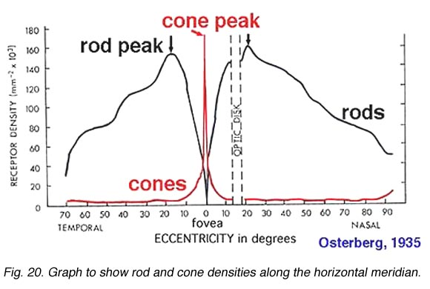
How does averted vision work?
http://webvision.med.utah.edu/imageswv/Ostergr.jpeg
Notes:
The distribution of rods and cones across the surface of the retina is not uniform – cones are clustered much more densely around the fovea, while rods are much more dense around the periphery of the retina. The fovea only occupies about 2 degrees of visual field – less than 0.01% of the total area of the retina.
The human retina contains about 125-130 million rods, but only about 6-7 million cones. At the fovea, cones are packed in at about 200,000 per square millimeter, with almost no rods in the fovea, but rods are about 90,000 per square millimeter outside the fovea. Rods and cones connect to bipolar cells, which connect to ganglion cells, which project into the visual cortex. But the signal from rods is highly convergent, so you get much better spatial resolution with cones than with rods.
Rods have much slower “integration times” than cones, so in addition to having lower spatial resolution than cones, they have less temporal resolution. So when viewing faint fuzzies, hold your eye in position for at least a few seconds, and your rods will be able to collect more photons, which should have a noticeable effect. Another trick for viewing faint fuzzies is to lightly tap your OTA tube, so the object moves a little. The human eye is exceptionally good at detecting motion (for reasons too detailed to cover here).

Slide 11
Homework
Is averted vision equally effective regardless of the direction to which you avert your eyes?
If not, in which direction should you look (up, down, left or right of the subject) for averted vision to be most effective?
Why would averted vision be more effective in one direction than others?
How far must you avert your eyes for maximal effectiveness?
What do these results tell you about the structure of the retina?
Notes:
Rods peak in density 18o or 5mm out from the center of the fovea in a ring around the fovea at 160,000 rods/mm2
No rods in central 200 µm.
Average 80-100,000 rods/mm2
Rod acuity peak is at 5.2 degrees or 1.5 mm from foveal center where there are 100,000 rods/mm2 (Mariani et al.,1984).

